Slide 1
Heterogeneous Graph Structure Learning for Graph Neural Networks
AAAI_2021
Code:https://github.com/Andy-Border/HGSL
2021.03.23 • ChongQing
Reported by Chenghong Li

Slide 2
Introduction
The success of the existing HGNNs relies on one fundamental assumption, i.e., the original heterogeneous graph structure is reliable.
However, this assumption is usually unrealistic, since the heterogeneous graph in reality is inevitably noisy or incomplete.
Considering the heterogeneity of different relations in heterogeneous graph, HGSL generates each relation subgraph separately.

Slide 3
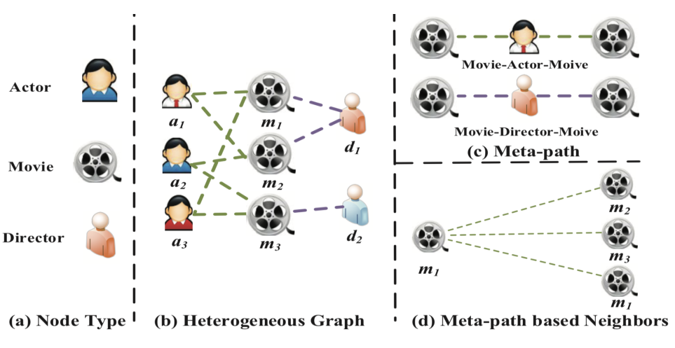
Introduction
WWW_2019_Heterogeneous Graph Attention Network

Slide 4
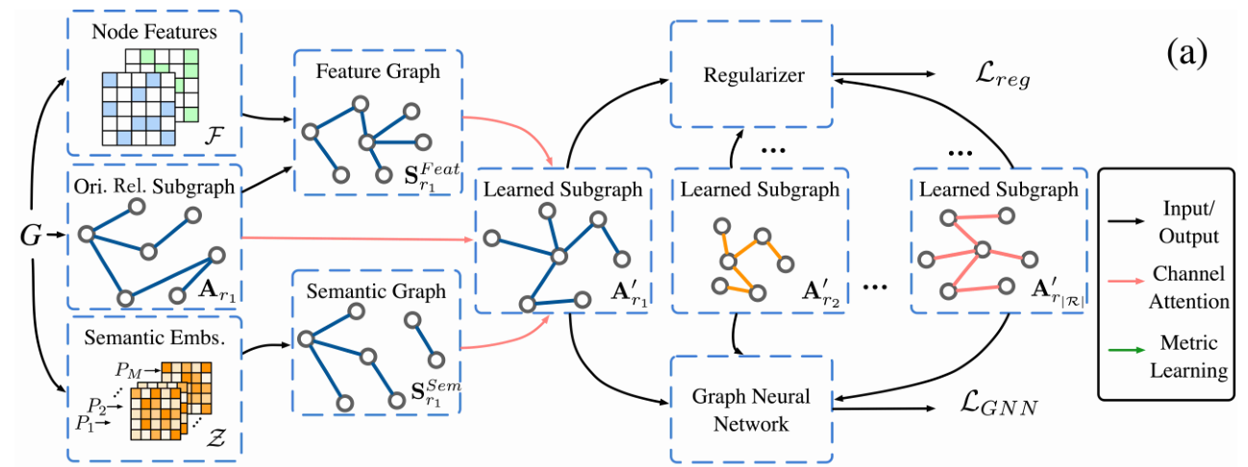
Method

Slide 5
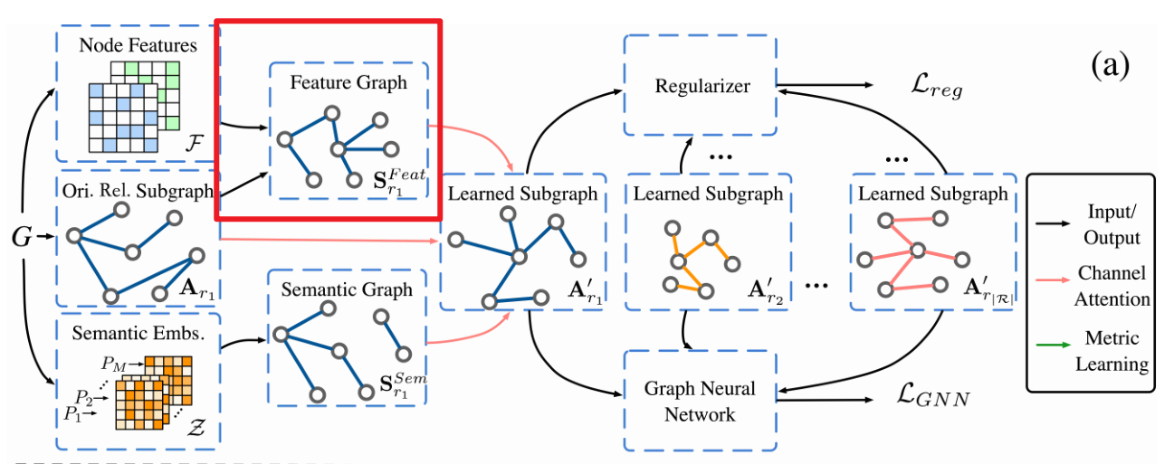
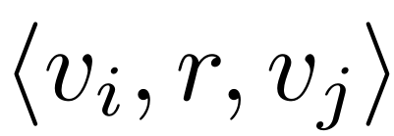
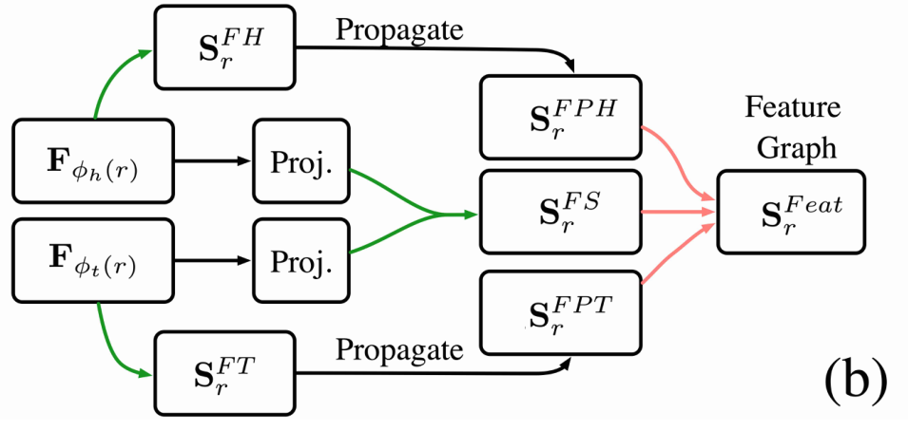
Method
Feature Similarity Graph：

Slide 6
Method
Feature Propagation Graph：
NeurIPS_2019_Graph Transformer Networks

Slide 7
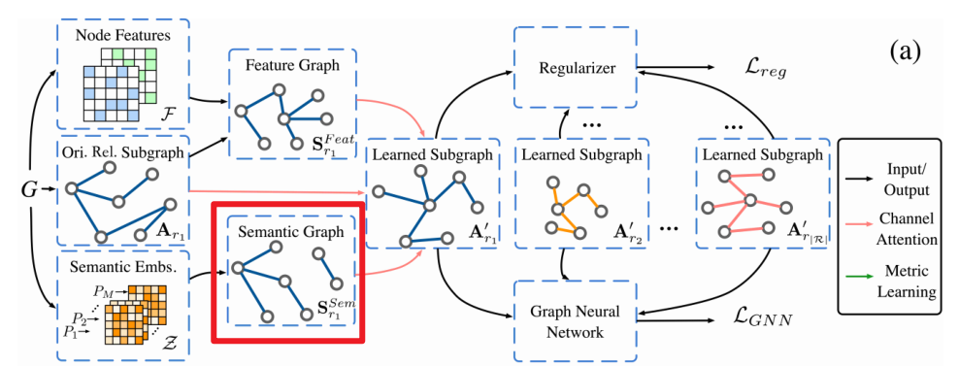
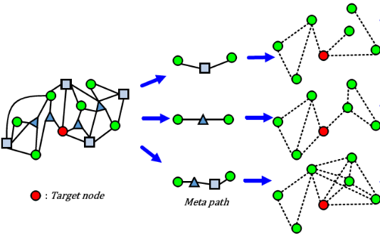
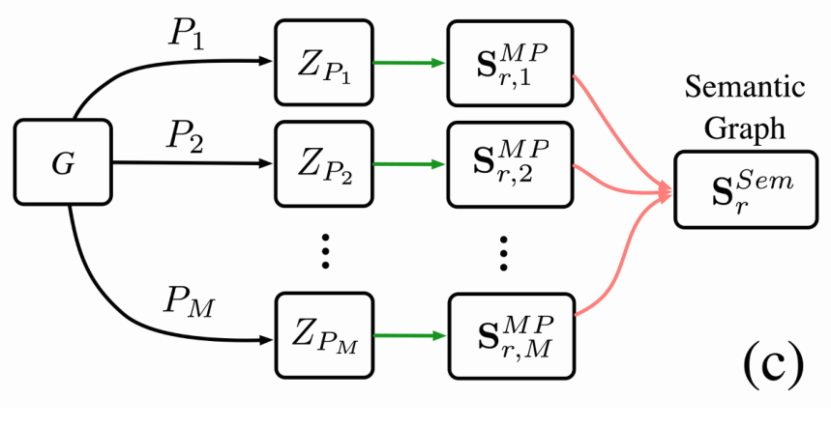
Method
KDD_2017_metapath2vec: Scalable Representation Learning for Heterogeneous Networks

Slide 8
Method

Slide 9
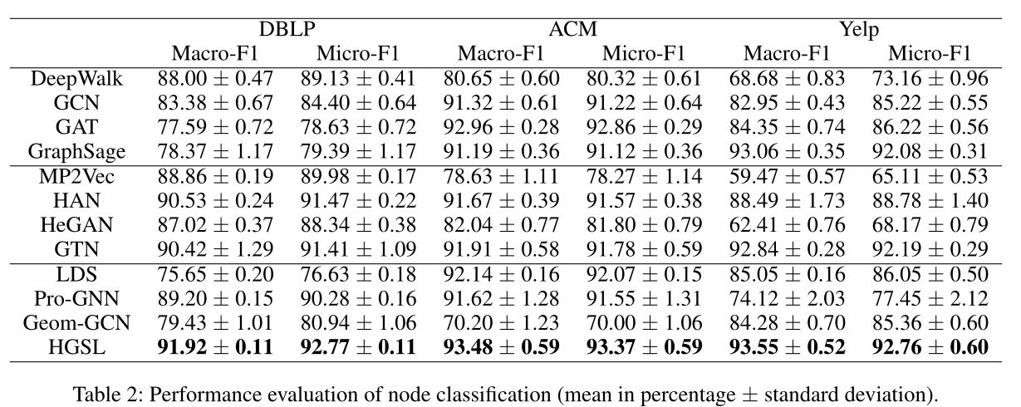
Experiments

Slide 10
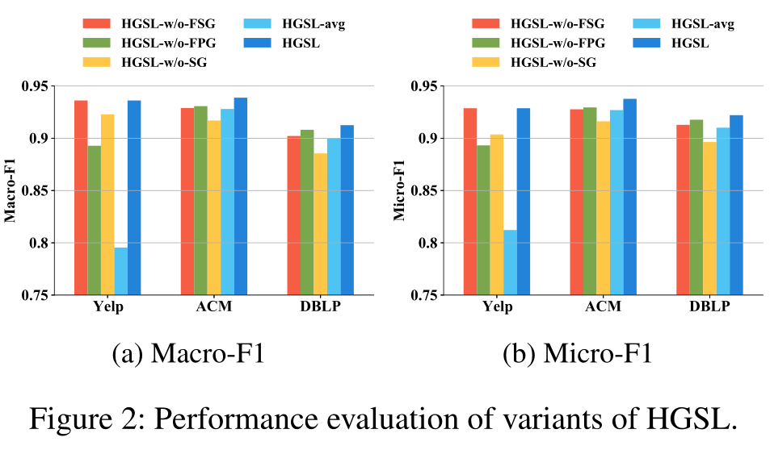
Experiments

Slide 11
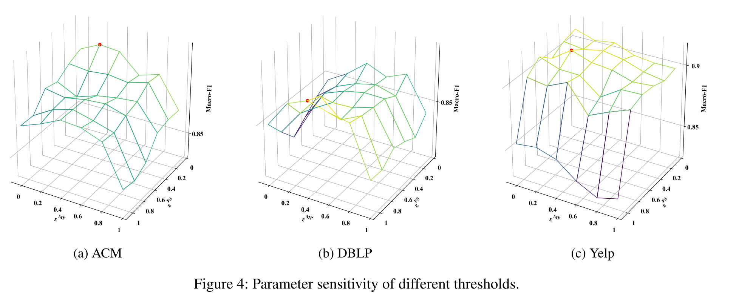
Experiments

